Slide 1
Learning ASP.NET Core Identity

Slide 2
ASP.NET Core Identity is a membership system that adds login functionality to ASP.NET Core apps. Users can create an account with the login information stored in Identity or they can use an external login provider. Supported external login providers include Facebook, Google, Microsoft Account, and Twitter.
Identity can be configured using a SQL Server database to store user names, passwords, and profile data. Alternatively, another persistent store can be used, for example, Azure Table Storage.

Slide 3
AddDefaultIdentity and AddIdentity
AddDefaultIdentity was introduced in ASP.Core 2.1. Calling AddDefaultIdentity is similar to calling the following:
AddIdentity
AddDefaultUI
AddDefaultTokenProviders

Slide 4
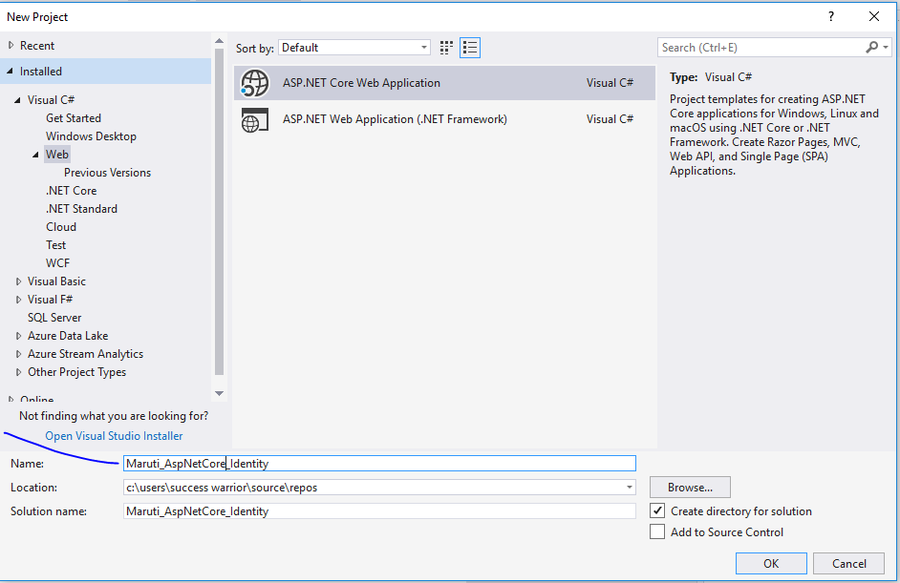

Slide 5
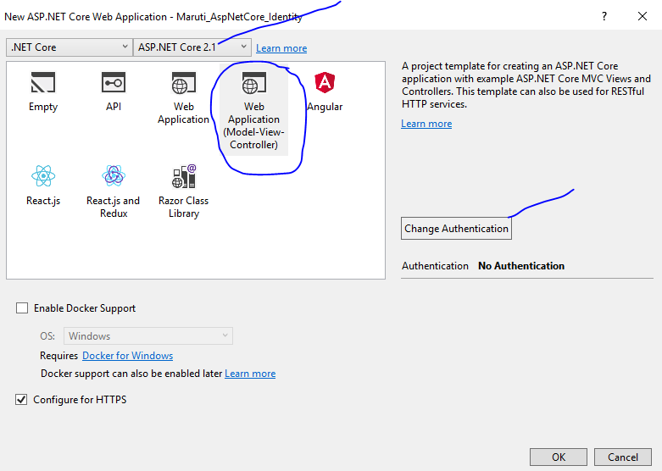

Slide 6
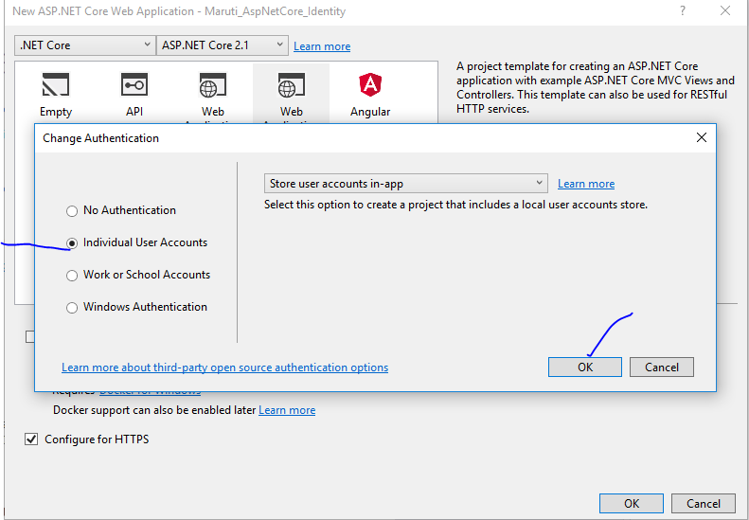

Slide 7
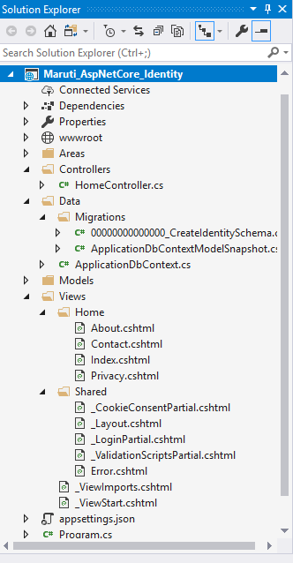

Slide 8
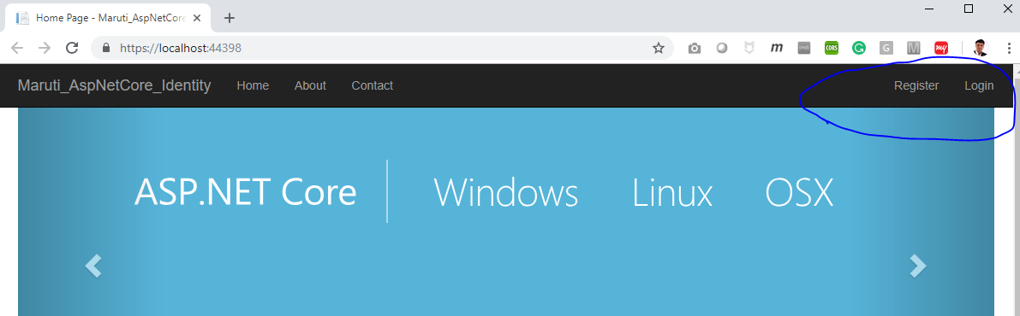
Run your project

Slide 9
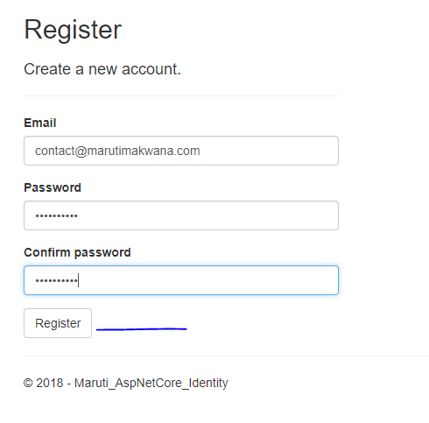

Slide 10
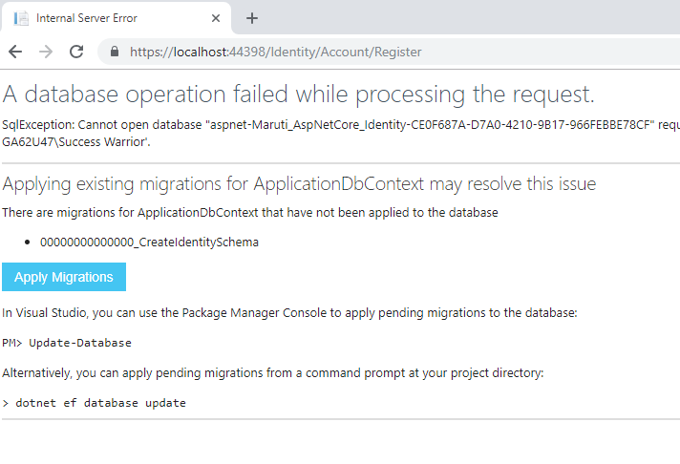
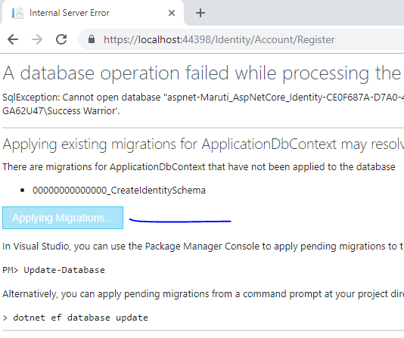

Slide 11
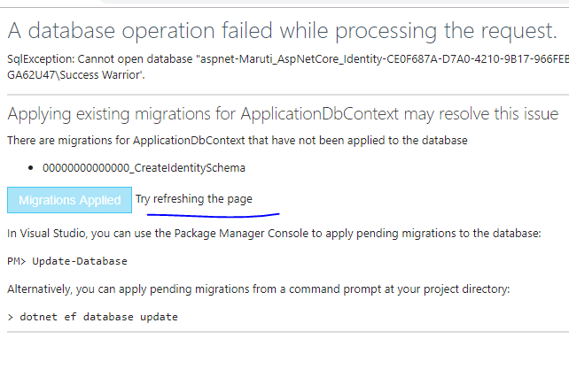

Slide 12
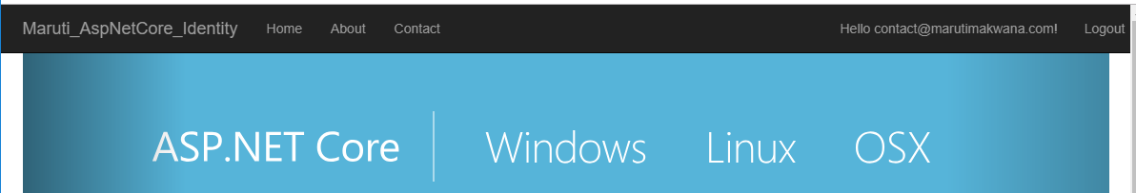

Slide 13
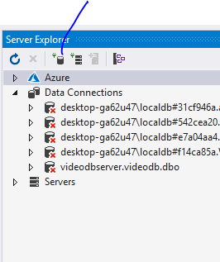
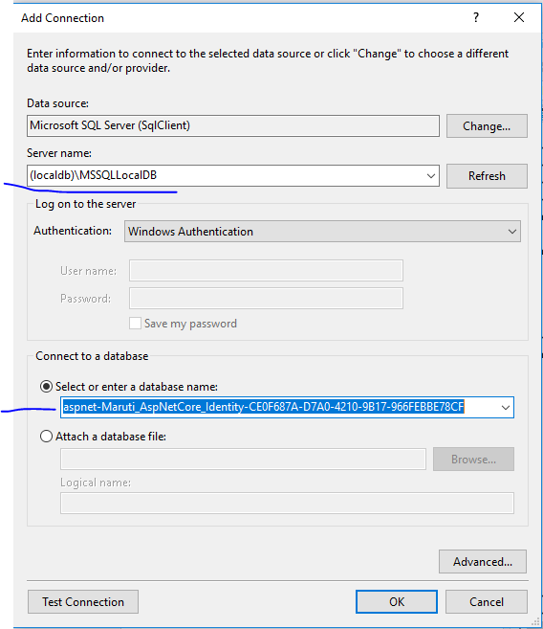

Slide 14
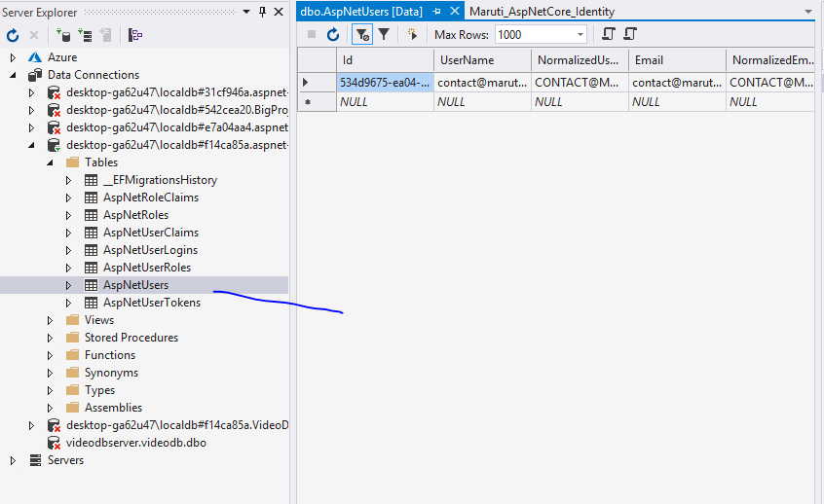

Slide 15
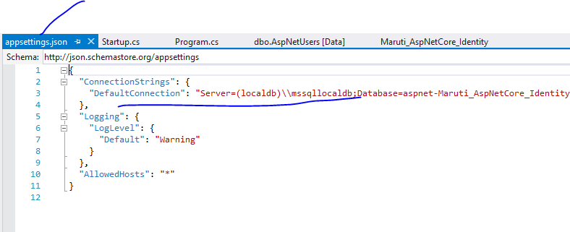

Slide 16
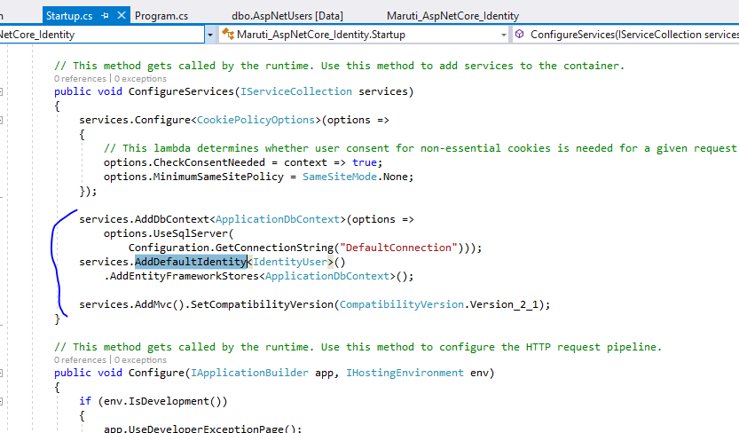

Slide 17
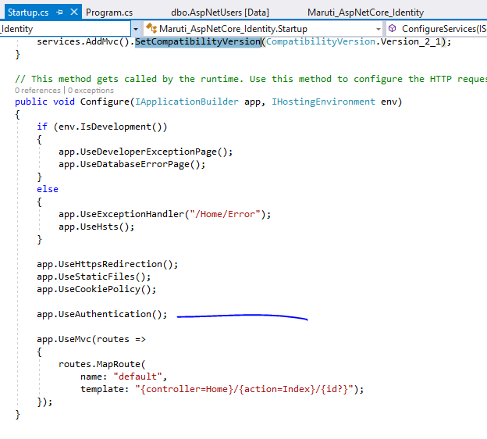
Identity is enabled by calling UseAuthentication.
UseAuthentication adds authentication middleware to the request pipeline.

Slide 18
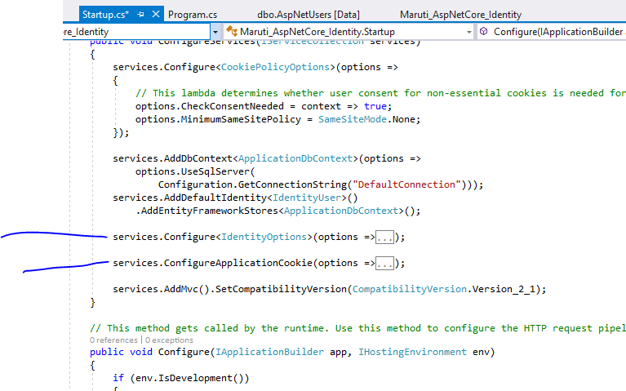
You can add your customization into services

Slide 19
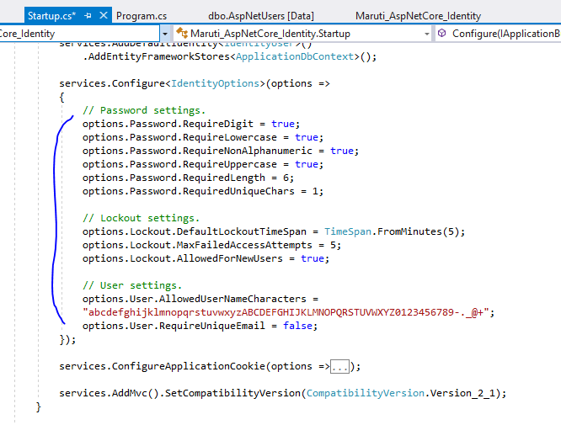

Slide 20
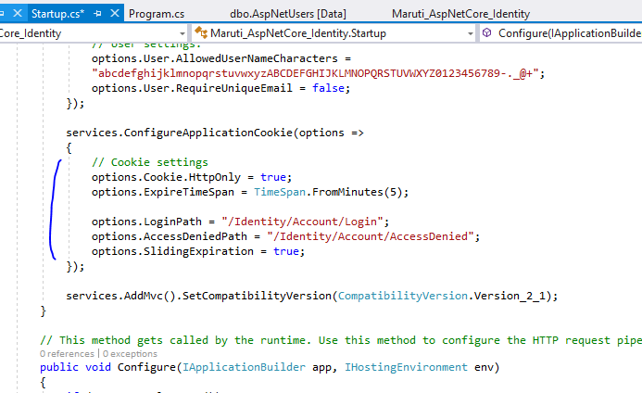

Slide 21
Scaffold Register, Login, and LogOut
ASP.NET Core 2.1 and later provides ASP.NET Core Identity as a Razor Class Library. Applications that include Identity can apply the scaffolder to selectively add the source code contained in the Identity Razor Class Library (RCL). You might want to generate source code so you can modify the code and change the behavior.

Slide 22
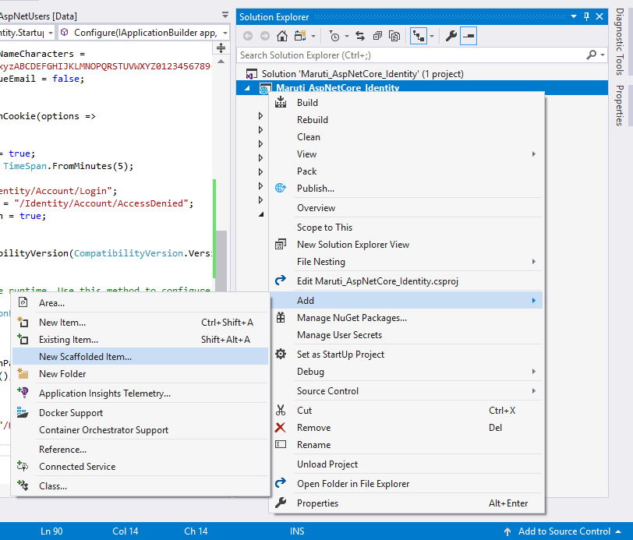

Slide 23
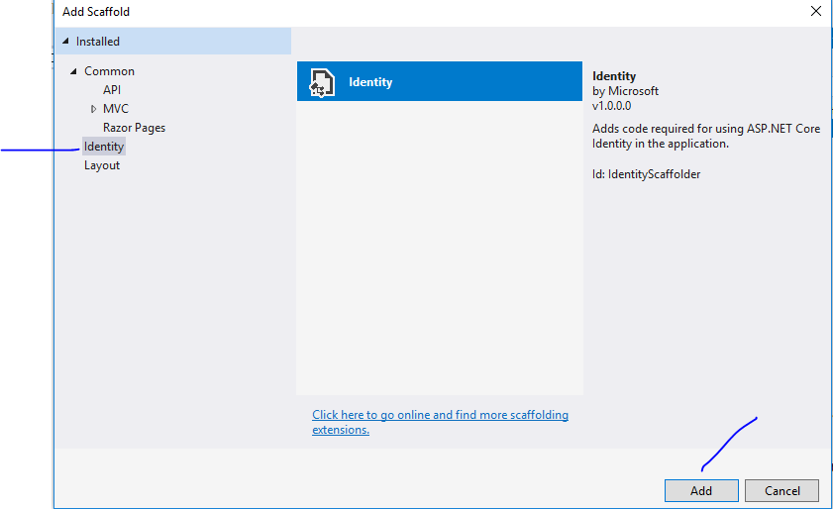

Slide 24
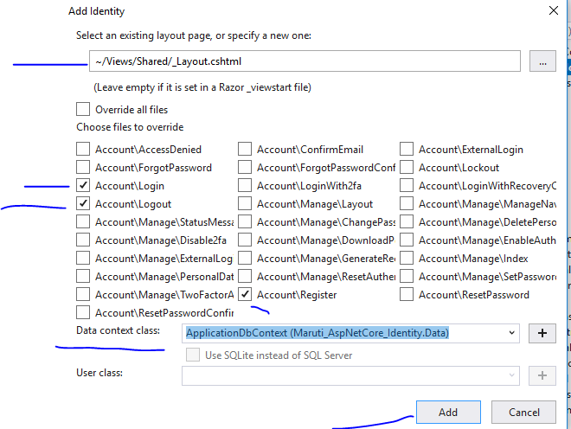

Slide 25
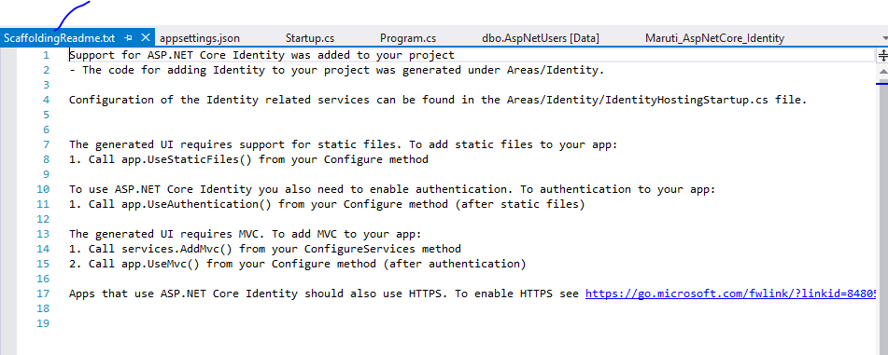

Slide 26
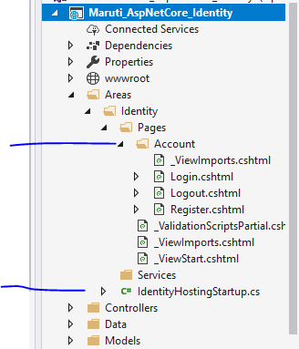

Slide 27
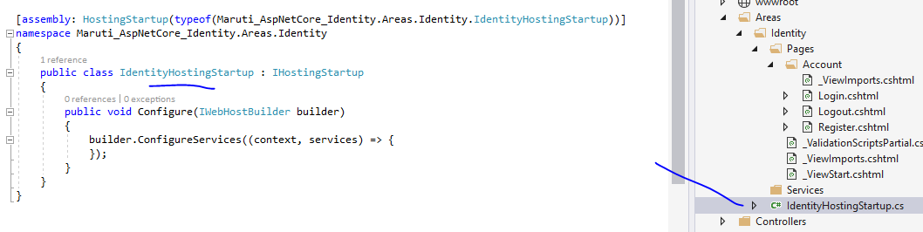

Slide 28
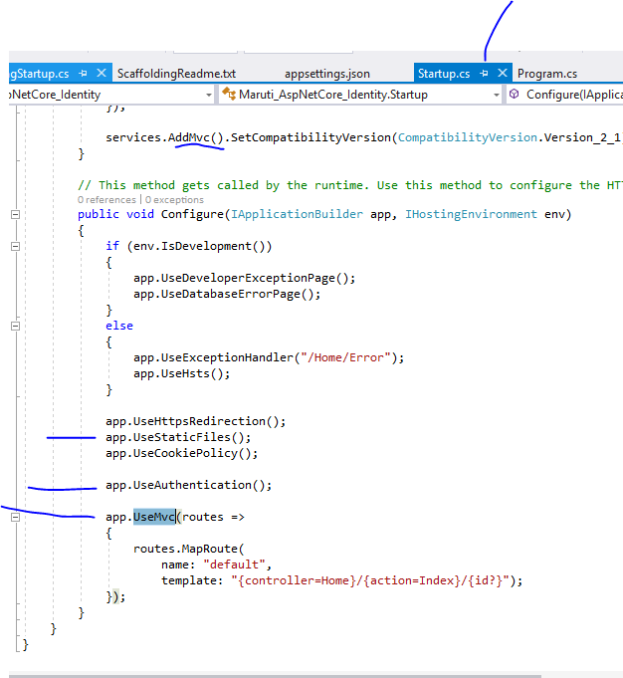
Its already there

Slide 29
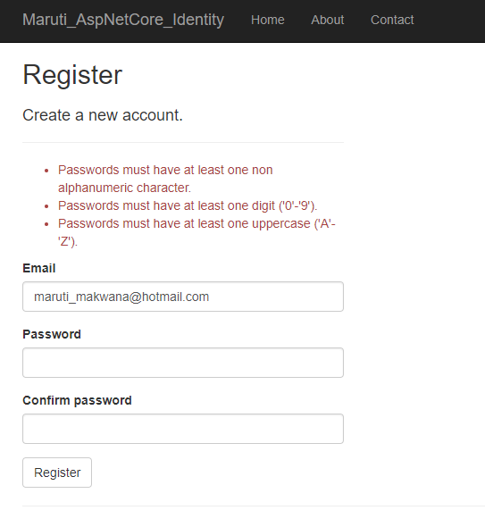
Run and Check

Slide 30



Slide 31
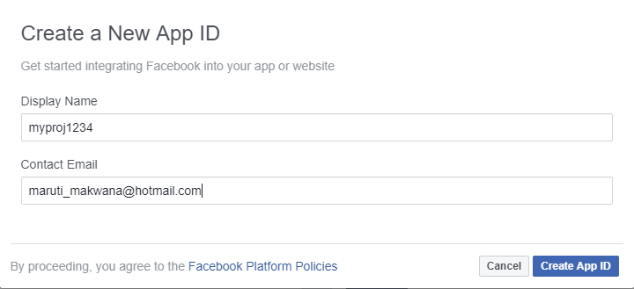

Slide 32
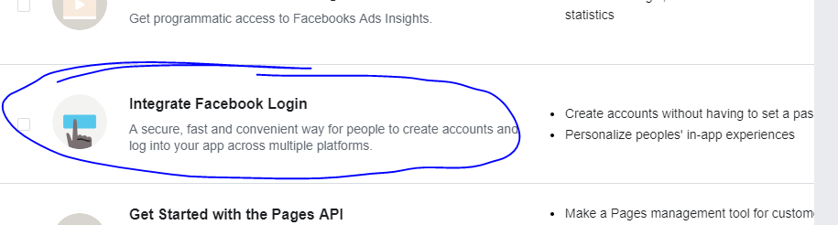

Slide 33
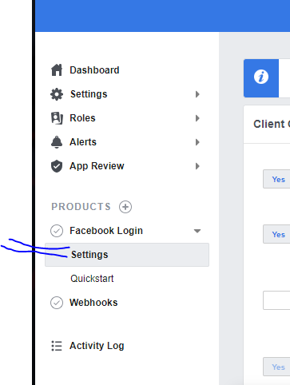

Slide 34
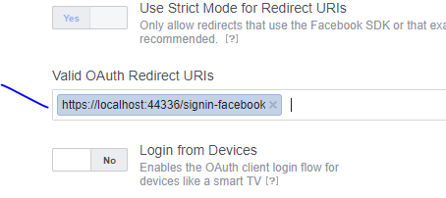

Slide 35
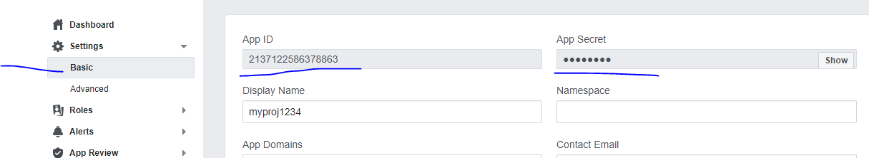

Slide 36
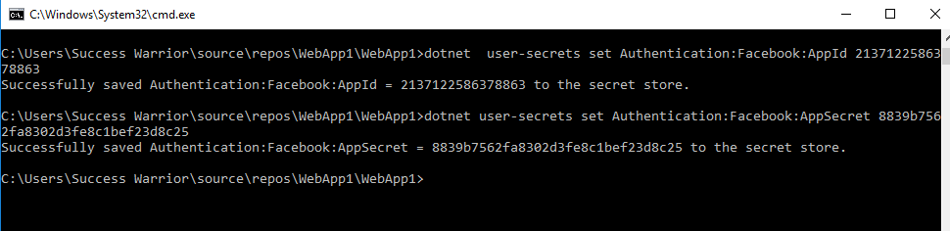
dotnet user-secrets set Authentication:Facebook:AppId <app-id>
dotnet user-secrets set Authentication:Facebook:AppSecret <app-secret>
dotnet user-secrets set Authentication:Facebook:AppId 2137122586378863
dotnet user-secrets set Authentication:Facebook:AppSecret 8839b7562fa8302d3fe8c1bef23d8c25

Slide 37
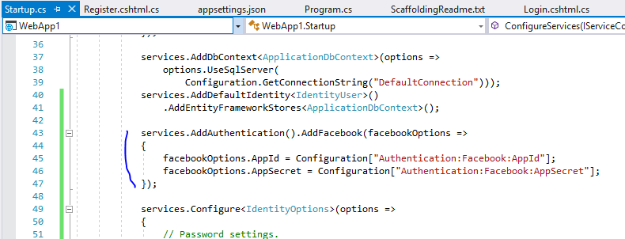

Slide 38
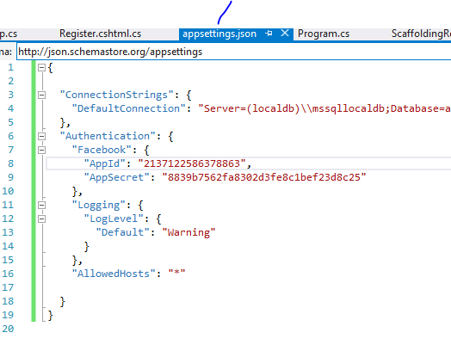

Slide 39
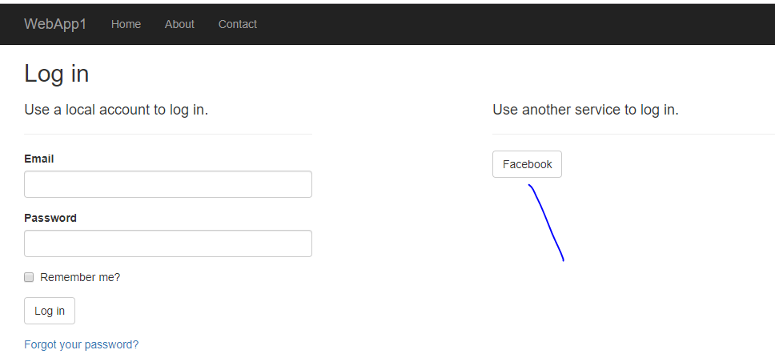

Slide 40
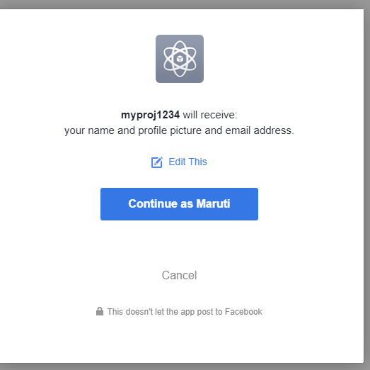

Slide 42
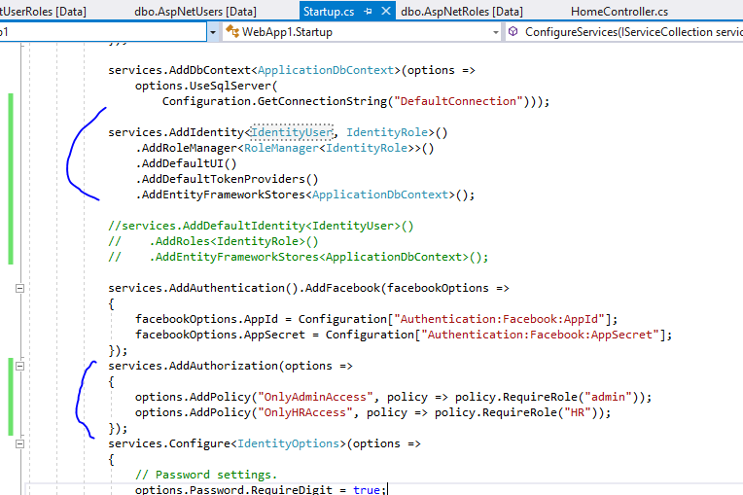

Slide 43
